Slide 1
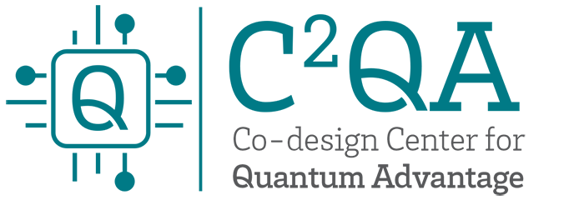





Foundations of
Quantum Computing
(QIS 301)
Dave Biersach
Brookhaven National Laboratory
dbiersach@bnl.gov
Session 03
Using Linux on the
Amazon Remote PC

Slide 2
Agenda
Understanding Amazon's Cloud
Installing Microsoft's Remote Desktop client on your PC
Accessing your Amazon hosted remote PC
Using the Xfce desktop on Linux (Ubuntu)
How to open the lab source code files in VS Code
How to run a Python script (program) in VS Code

Slide 3
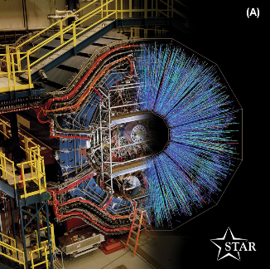
Scientific Computing in the Cloud
The cloud is a great equalizer
Allows participants to continue learning at home as on campus
Cloud machines are fully isolated from school networks - eliminates local software installation restrictions & campus cybersecurity concerns
Schools with low-end PC labs can still access the newest generation of hardware

Slide 4
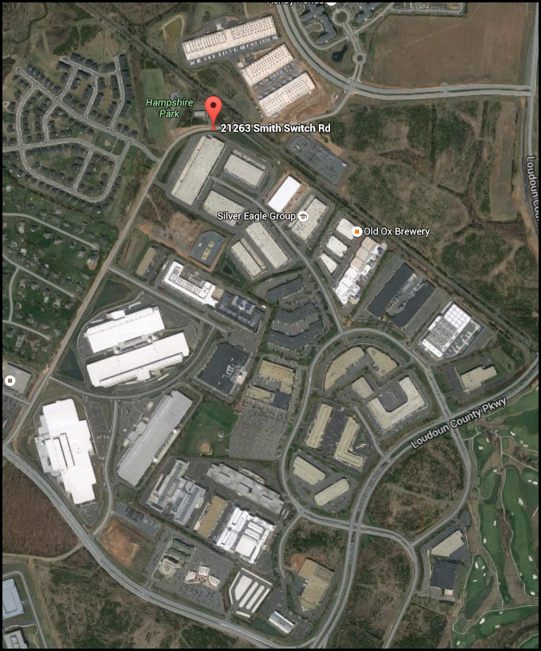
Amazon’s
23 data centers in Ashburn, Virginia

Slide 5
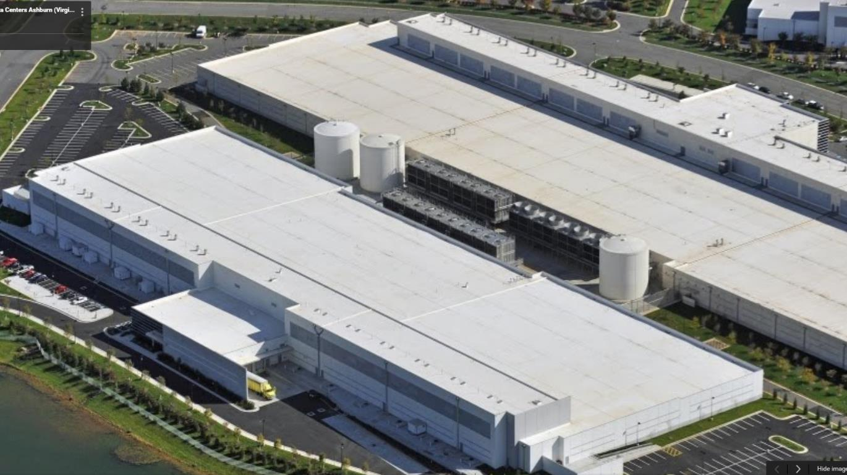
Just two of Amazon’s 23 cloud
data centers in Ashburn, Virginia

Slide 6
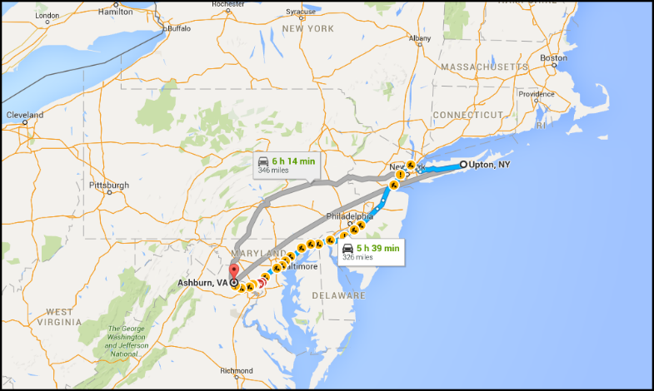
BNL ↔ Ashburn
Roundtrip = 660 miles

Slide 7

Accessing an Amazon Remote PC
Write down your IP address, username, and password in your notebook
Take a picture of your login information to keep on your smart phone

Slide 8
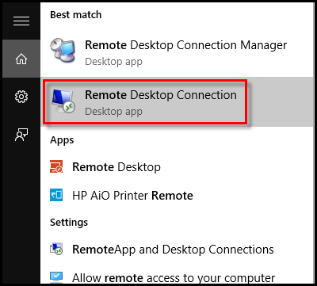
Accessing an Amazon Remote PC
Use the Microsoft Remote Desktop Connection application
Students have assigned credentials
The IP address (computer name) of their specific machine in Amazon’s cloud
Their username (case sensitive!)
Their password (case sensitive!)
Students can access their Amazon machine from their home
Educators can remotely monitor student progress real-time on the lab exercises

Slide 9
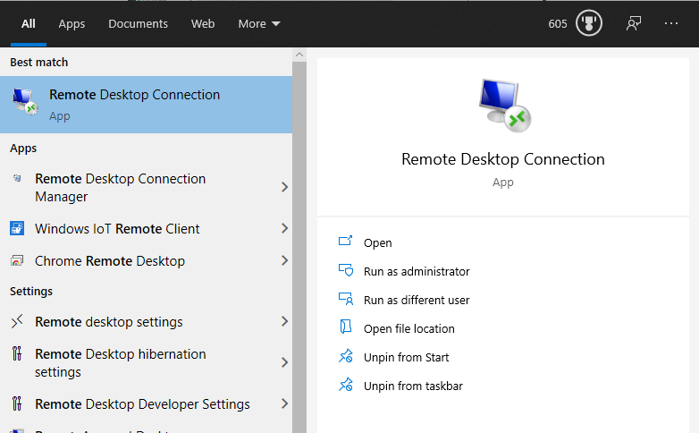
Microsoft's Remote Desktop on Windows
If you have Microsoft Windows, the Remote Desktop Connection application is already installed
Click the Windows button on the task bar, and search for "Remote Desktop" – it should appear in the search results

Slide 10
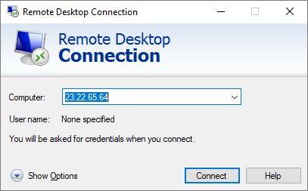
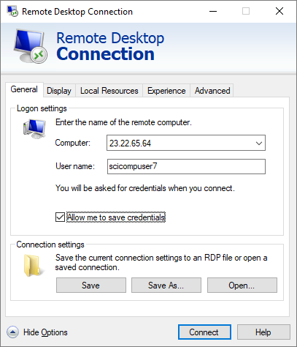
Microsoft's Remote Desktop on Windows
Enter your IP address
Enter your username
Click on
“Show Options”
Click on
“Connect”
Click on
“Save Credentials”

Slide 11
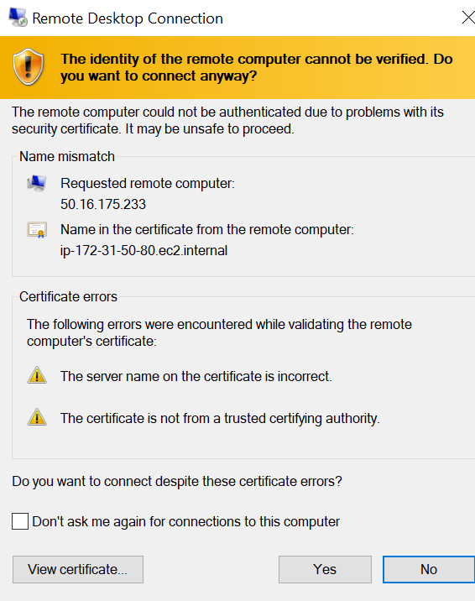
Microsoft's Remote Desktop on Windows
Click “Don’t ask me again…”
Click “Yes”

Slide 12
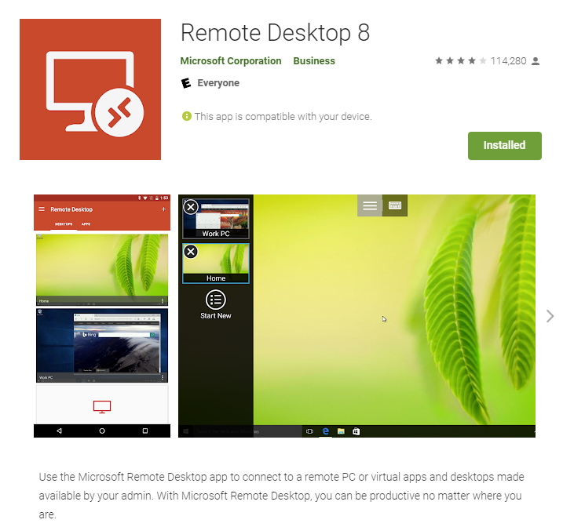
Microsoft's Remote Desktop on Chromebooks
The Remote Desktop app is free in the Google store
https://play.google.com/store/apps/details?id=com.microsoft.rdc.android&hl=en_US

Slide 13
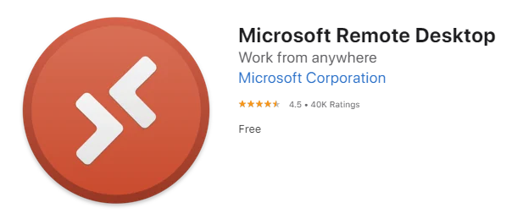
Microsoft's Remote Desktop on macOS
If you have run macOS – the app is free in the Apple store
https://apps.apple.com/us/app/microsoft-remote-desktop/id1295203466?mt=12

Slide 14
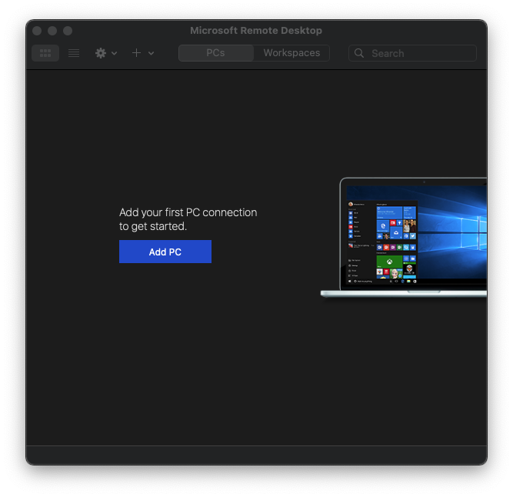
Microsoft Remote Desktop on macOS

Slide 15
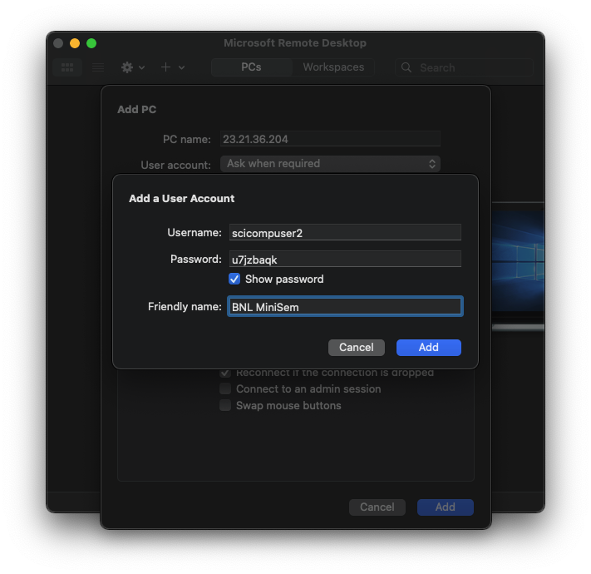
Microsoft Remote Desktop on macOS
Only enter the username and password for YOUR Amazon PC!

Slide 16
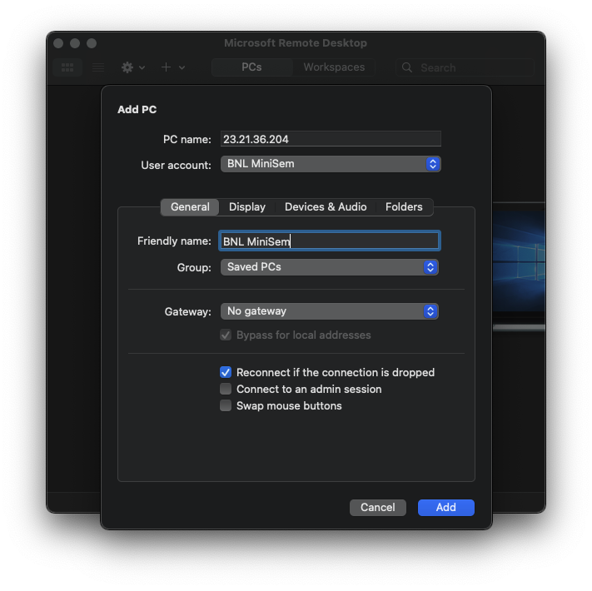
Microsoft Remote Desktop on macOS
Only enter the IP Address of YOUR Amazon PC!

Slide 17
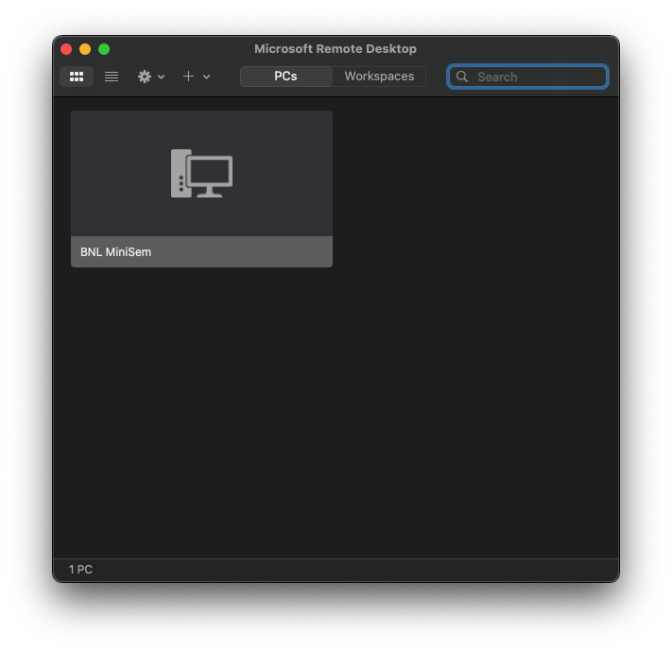
Microsoft Remote Desktop on macOS
Double click to connect to your Amazon PC

Slide 18
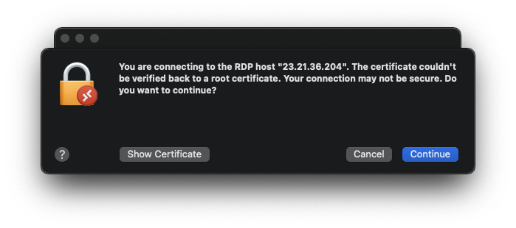
Microsoft Remote Desktop on macOS
Double click to connect to your Amazon PC
This is an expected warning – just click "Continue"

Slide 19
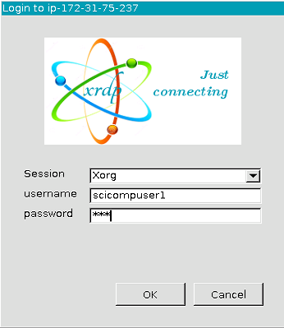
Accessing an Amazon Remote PC
Ensure “Xorg” is selected
Enter your username
Click “OK”
Enter your password

Slide 20
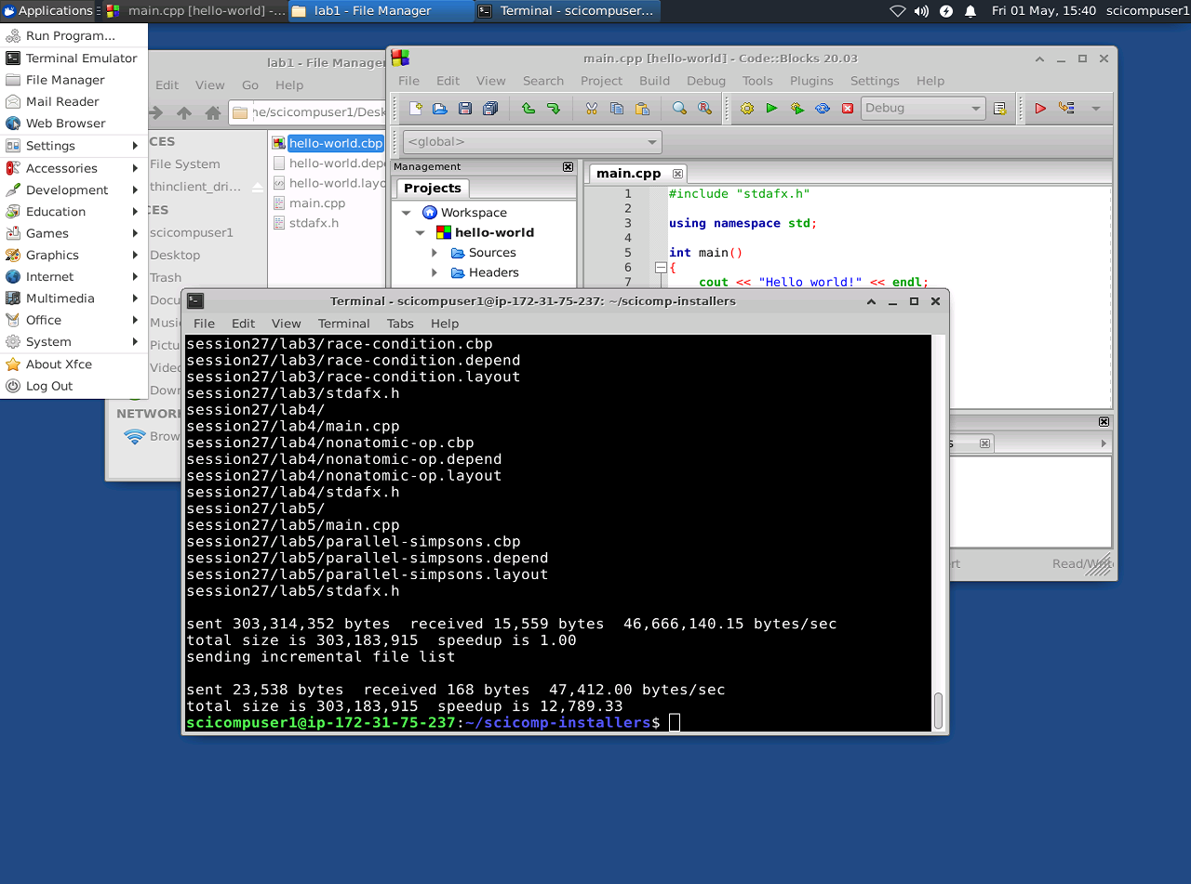
Ubuntu Linux with Xfce Desktop
The “Start” button is at the top-left of the desktop
Ubuntu 20.04 LTS (64-Bit)
Xfce 4.14 Desktop

Slide 21
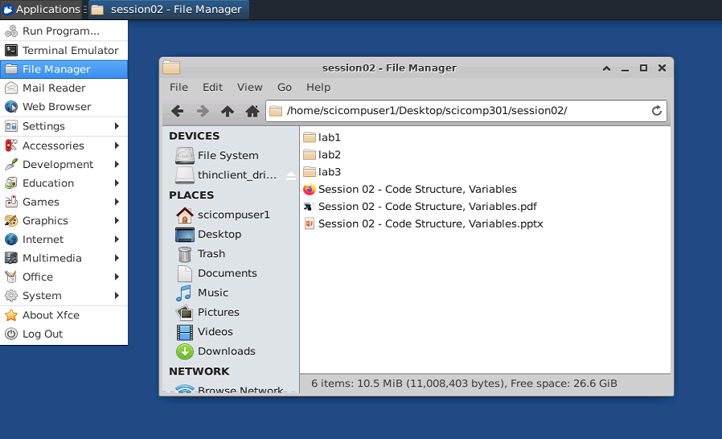
Ubuntu Linux with Xfce Desktop
The File Manager
works like
Windows Explorer or
Apple Finder

Slide 22
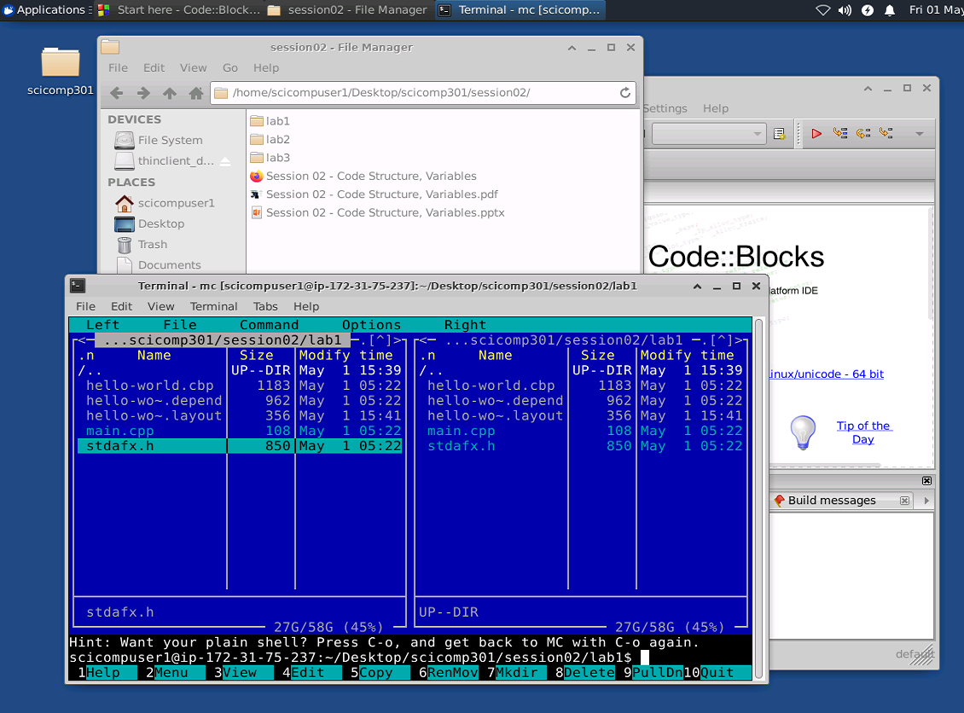
Ubuntu Linux with Xfce Desktop
Windows can be minimized, maximized or closed using these buttons

Slide 23
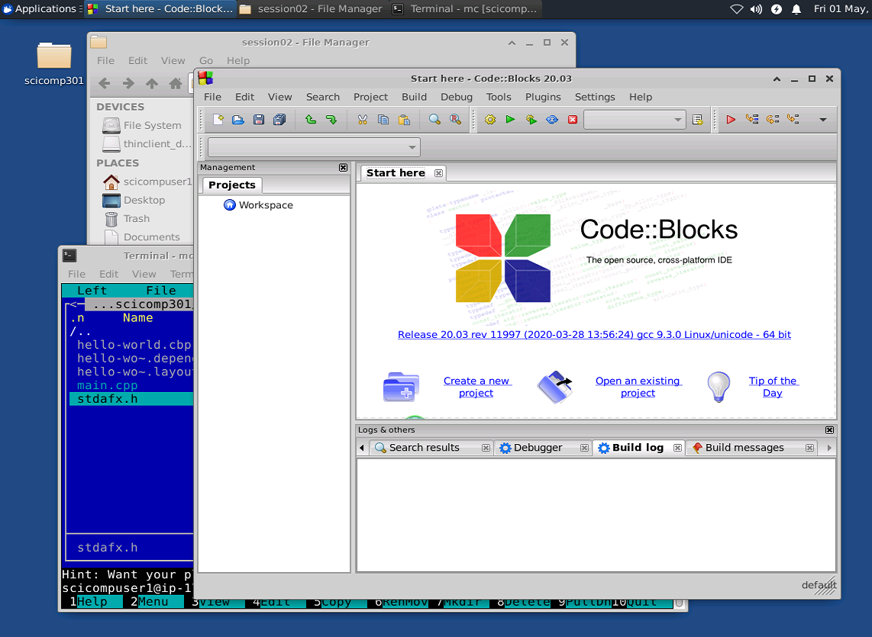
Ubuntu Linux with Xfce Desktop
Windows can be moved by left-click & dragging their title bar

Slide 24
Ubuntu Linux with Xfce Desktop
Open windows and running apps appear in the task bar at the top of the desktop

Slide 25
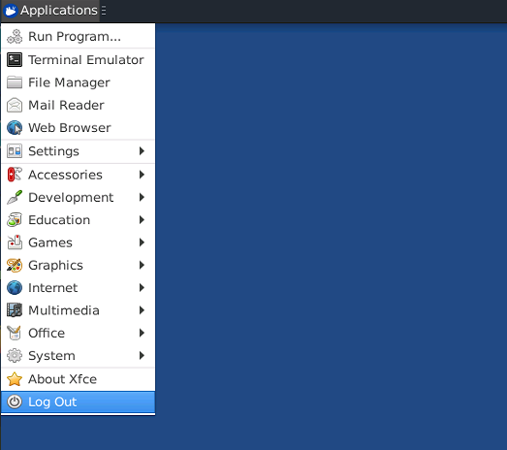
Ubuntu Linux with Xfce Desktop
Use the “Applications…Log Out” button to exit your Amazon PC

Slide 26
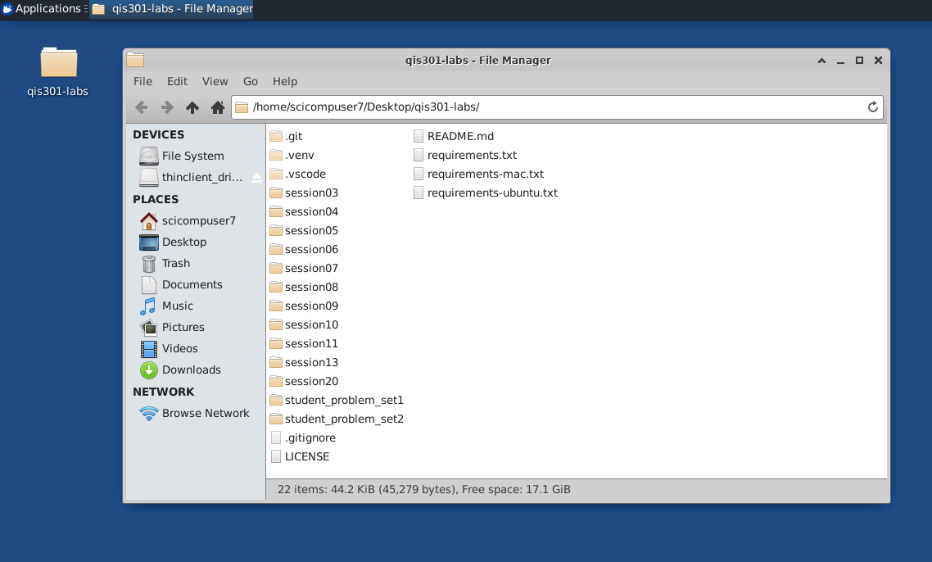
SciComp Courseware Layout
The workshop source code is in this folder on your Amazon Desktop

Slide 27
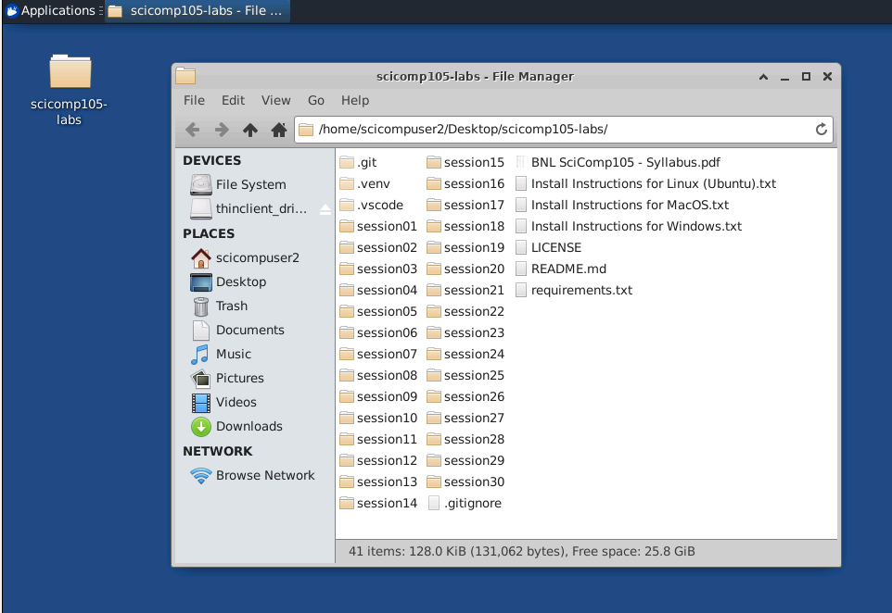
SciComp Courseware Layout

Slide 28
SciComp Courseware Layout
You will NOT be accessing the lab source code files from the desktop file manager!

Slide 29
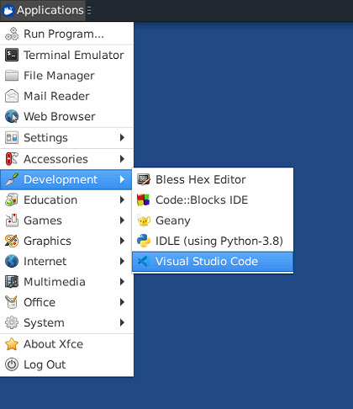
Opening qis301-labs folder in VSCode
Launching VS Code on the Linux (Xfce) desktop

Slide 30
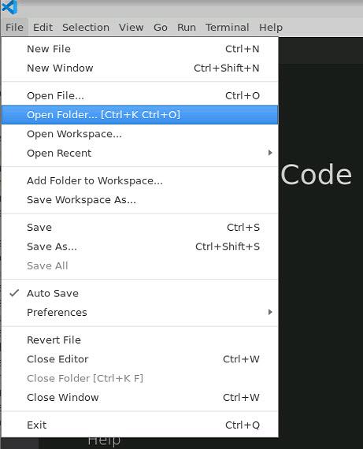
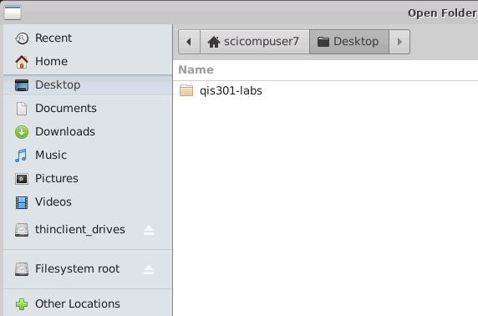
Opening qis301-labs folder in VSCode
This example shows opening a workspace folder in VS Code on Linux (Xfce)

Slide 31
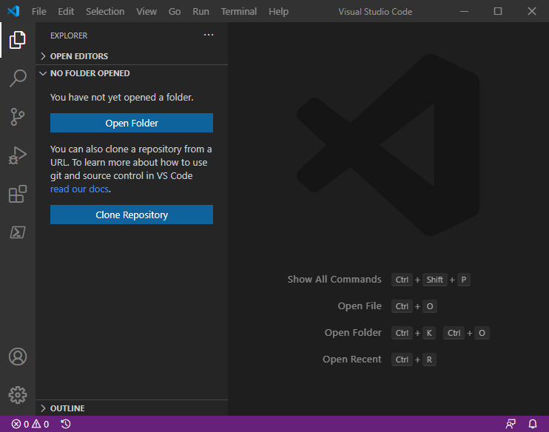
Opening qis301-labs folder in VSCode
Opening a workspace folder from within
VS Code itself

Slide 32
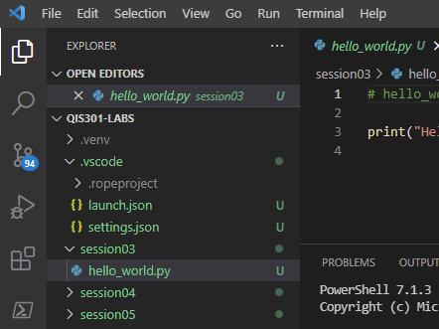
Opening qis301-labs files in VSCode
Within the workspace, the files tab will show you a subfolder for each QIS301-LABS session, along with the Python scripts for that session
Double click on a *.py file to open the script in the main editor window

Slide 33
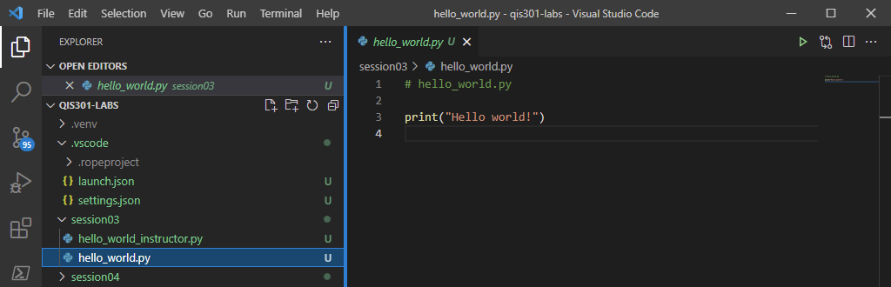
Running a Python Script in VSCode
To execute a Python program in the workspace, click the green arrow in the top-right of the editor window
You can also run the program in the debugger by pressing F5

Slide 34
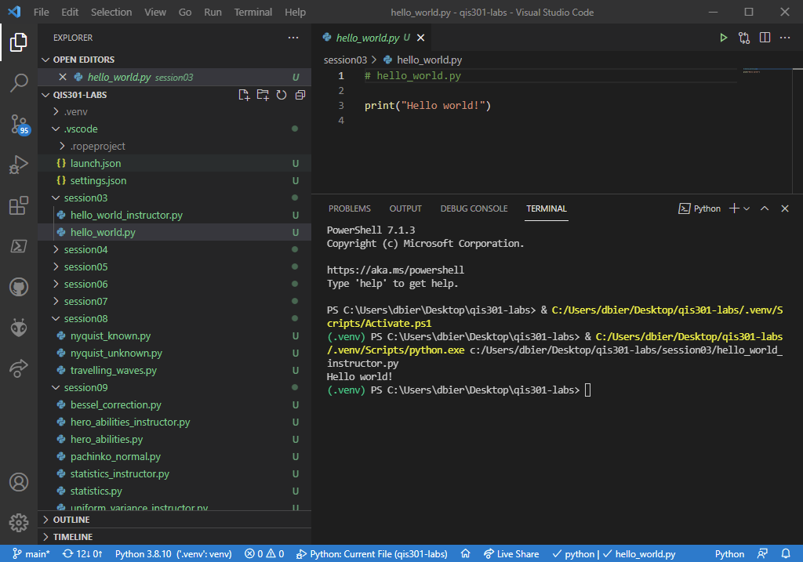
Running a Python Script in VSCode
☺

Slide 35
Reminders
In Linux, both usernames and passwords are case-sensitive
Please ensure you are logging on with your credentials
Do not open a .py file using the desktop file manager!
Instead, you must first launch VS Code, and then open the qis301-labs folder within VS Code
VS Code should remember your previously open workspace (folder) and by default open it again automatically
Don't have multiple instances of VS Code running on your desktop
Log off your Amazon PC when you are done with a session

